Slide 1
Hiring process analytics
A Project on Statistics

Slide 2
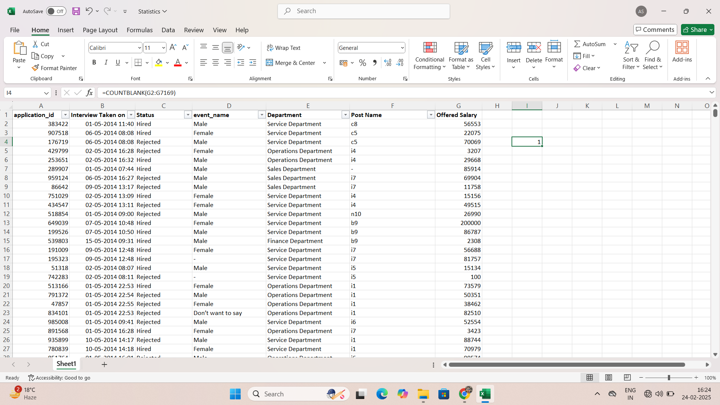
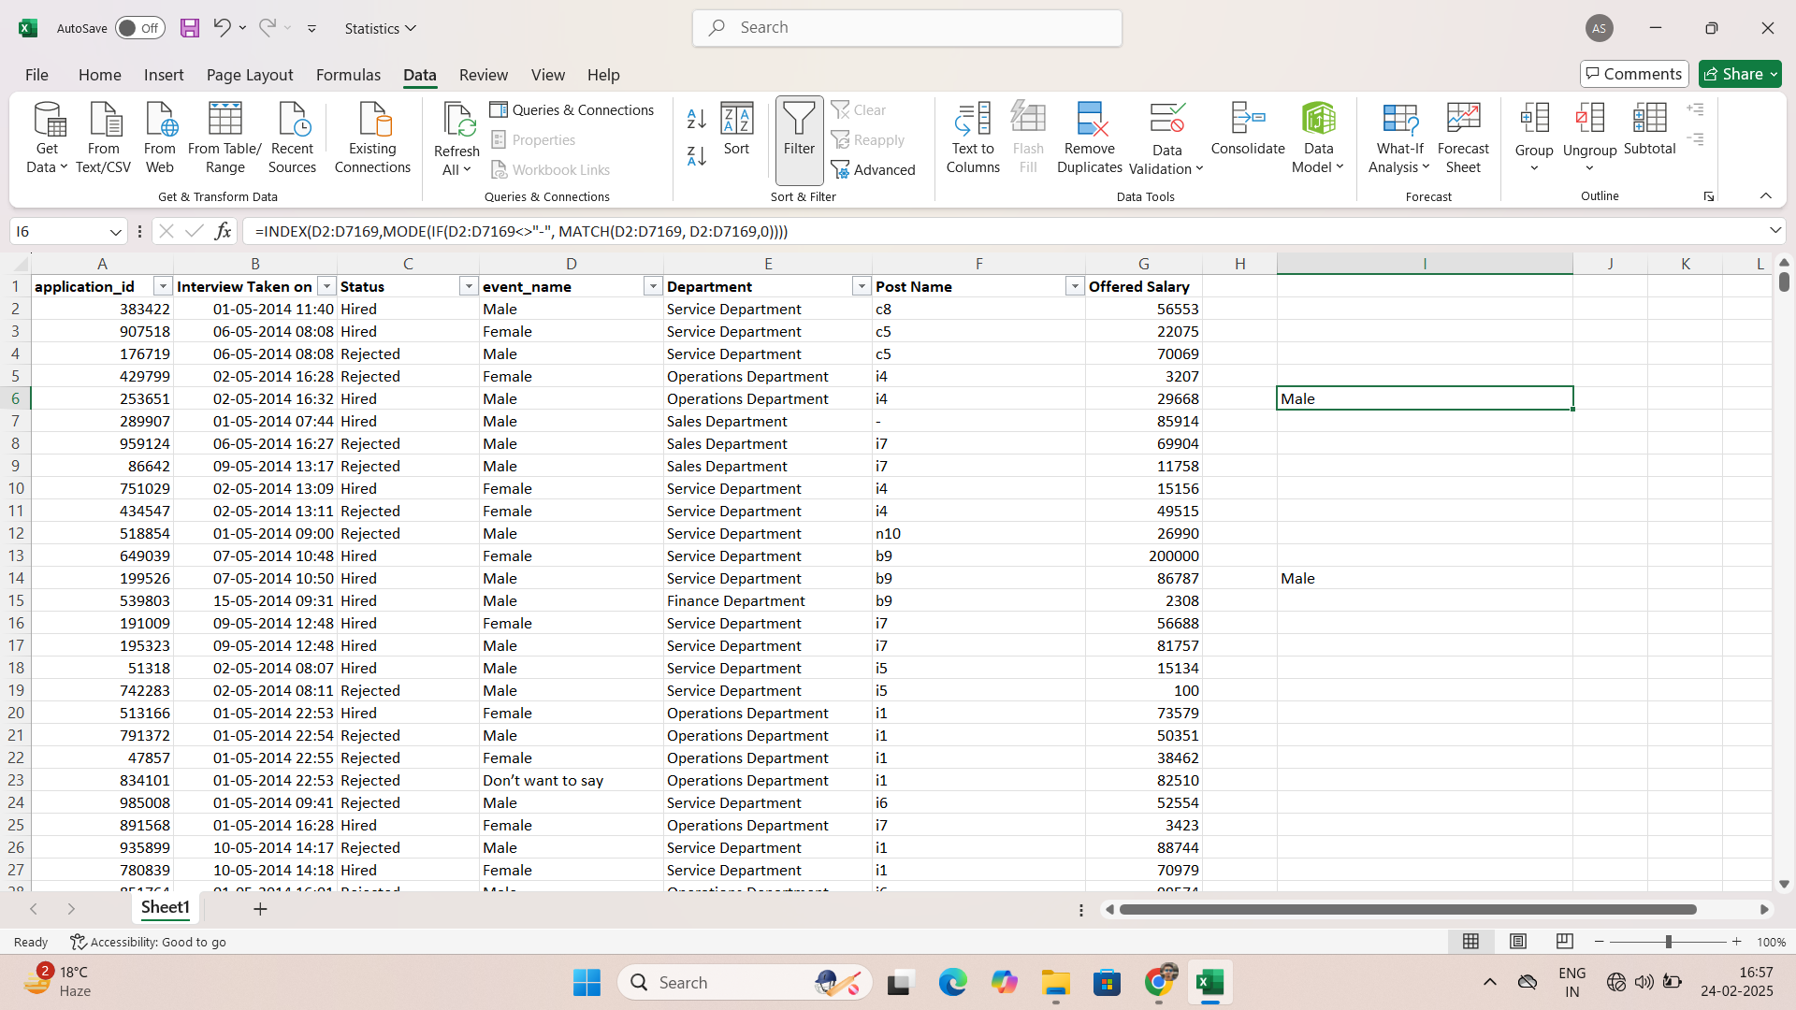
Missing data and Replacement
Found Missing Data (Blanks and “-”) and replaced categorical data with mode of the column and numerical data with median
of the column.

Slide 3
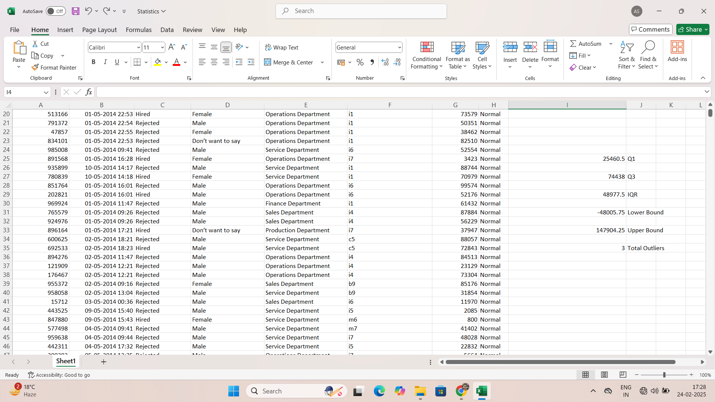
Outliers
Calculated outliers with IQR method in Salary
column as it is the only column with numerical
data.
First calculated quartile 1 and quartile 3.
Then calculated IQR and lower bound and
upper bound.
Got 3 outliers in the salary column i.e. Salary
200000, 300000 and 400000.
Left all the 3 outliers as it is as the department
of those 3 persons is General Management
and it is most likely the real salary, hence can
not be ignored or replaced.

Slide 4
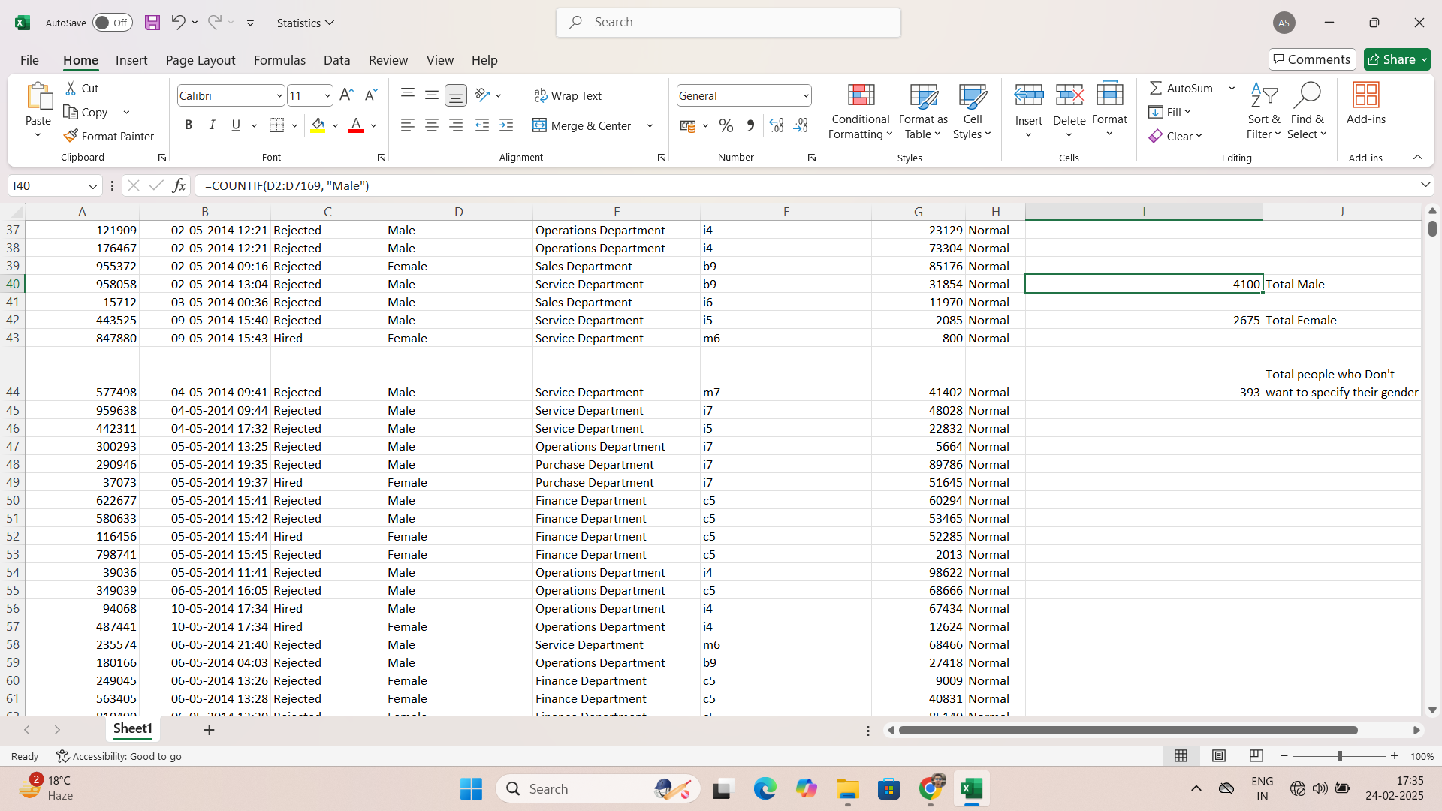
Hiring analysis
Calculated total number of males, females and people who do not prefer telling their gender.
Got result that there are approximately 1.5 times male employees than female employees.

Slide 5
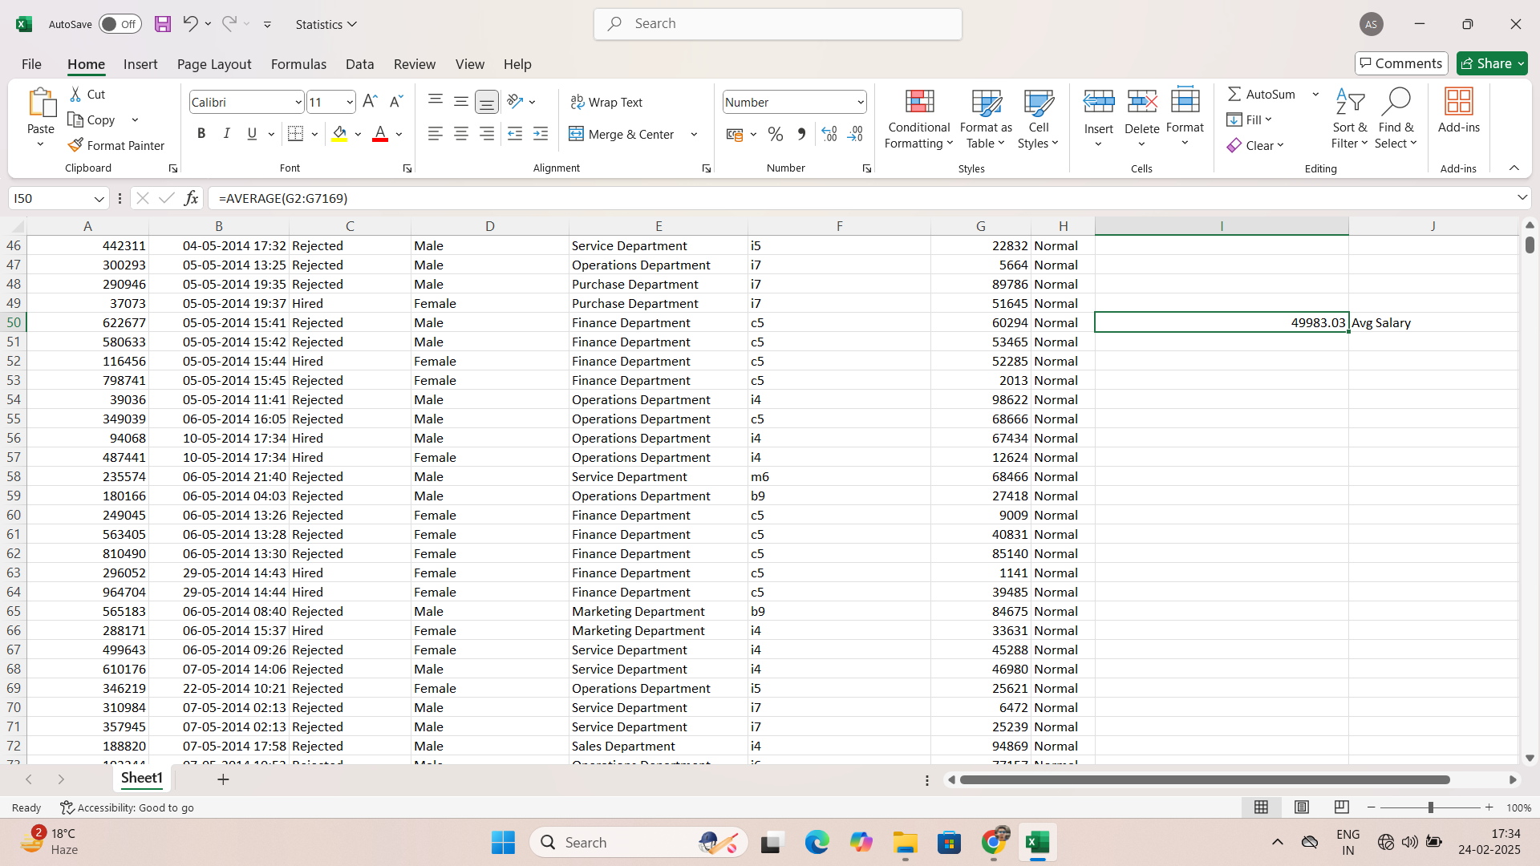
Salary analysis
Calculate average of salary of all the employees.
Average Salary- 49983.03.

Slide 6
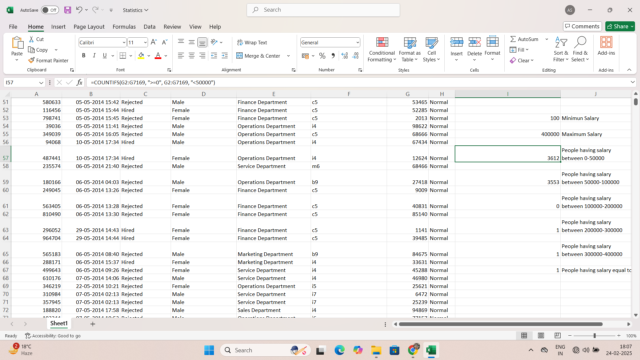
Salary Distribution
Minimum Salary- 100
Maximum Salary- 400000
People having salary between 0-50000 – 3612
People having salary between 50000-100000 – 3553
People having salary between 100000-200000 – 0
People having salary between 200000-300000 – 1
People having salary between 300000-400000 – 1
People having salary equal to or more than 400000 – 1

Slide 7
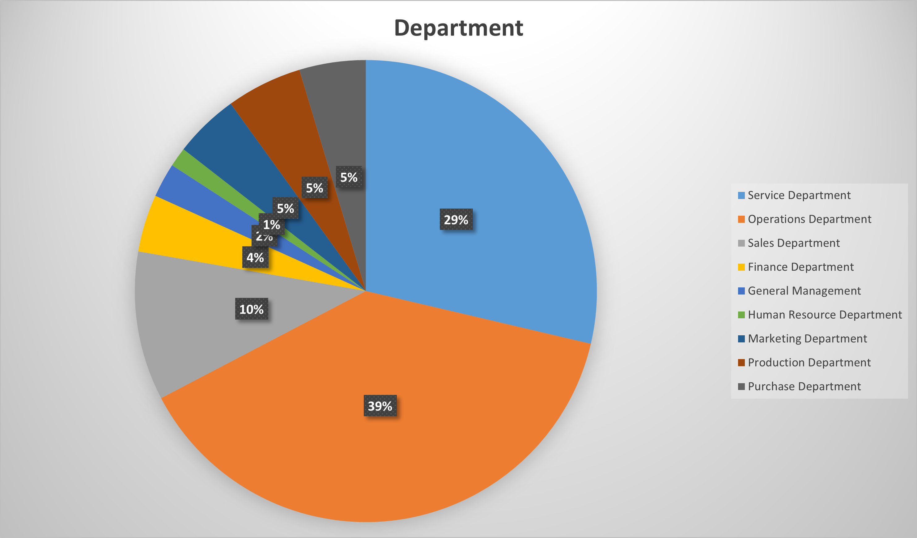
Departmental analysis
Department wise percentage distribution of employees.

Slide 8
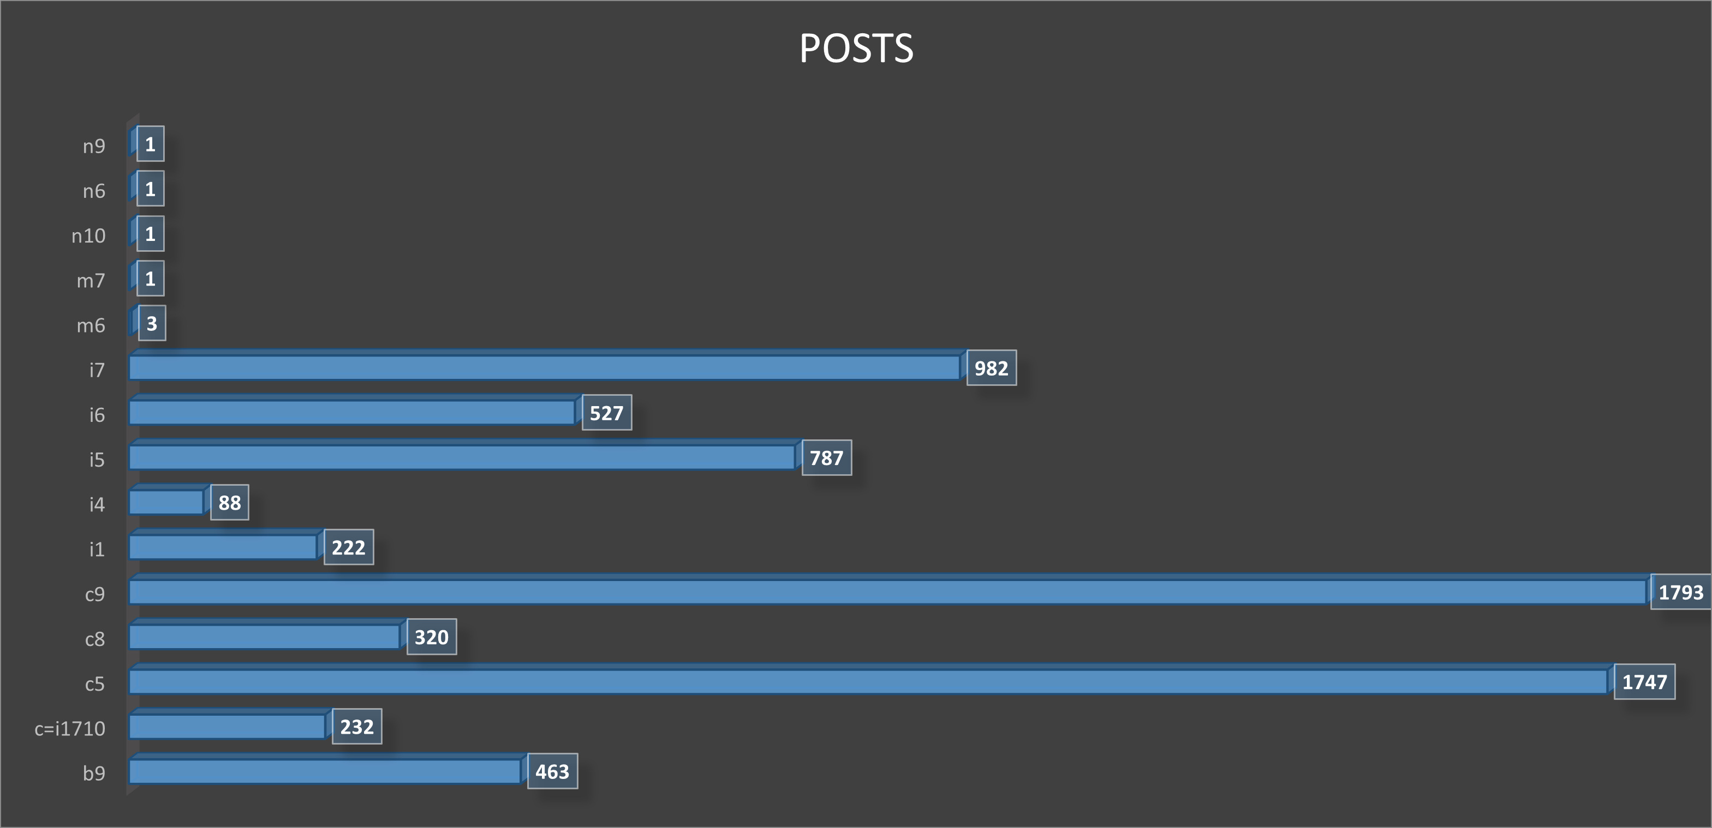
Position tier analysis
Posts wise distribution of number of employees.

Slide 9
Excel sheet link
https://docs.google.com/spreadsheets/d/1oG6IxopsYauE6tchK_fyigGH1WJNr69S/edit?usp=sharing&ouid=100987342170051497390&rtpof=true&sd=true

Slide 10
Thank you
BY-
ALANKAR SAXENA

